Slide 1

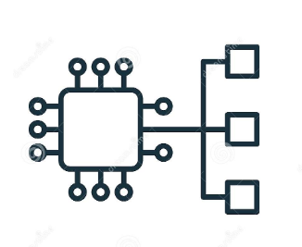
Amazon Eks cluster

Slide 2
Why Eks cluster?
Kubernetes is an open-source system for automating the deployment, scaling and management of containerized applications.
Eks provides a high available and fully managed Kubernetes control panel/service that makes it easy for you to run Kubernetes.
Images can be build and deploy the worker nodes to Amazon Eks cluster.

Slide 3
Eks topology
Master Node -: These are the control nodes which are deployed in AWS manged VPC and access through network interface.
Worker Node -: These are the data nodes deployed in Aws worker VPC and use to host workload.

Slide 4
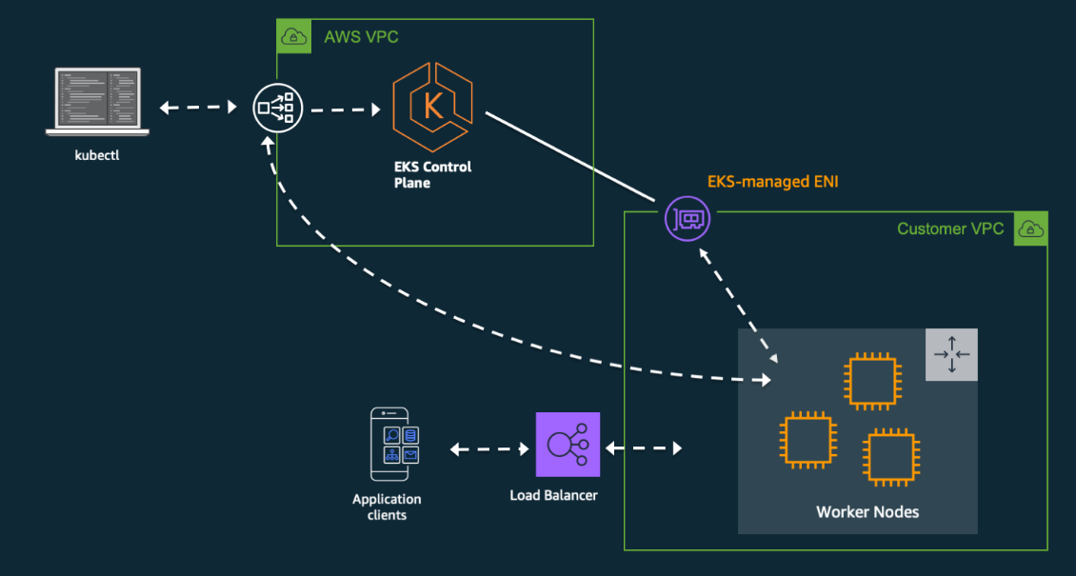
Eks diagram

Slide 5
Eks requirements
Define containerized application delivery process to Eks.
Create and scan the Docker image.
Attach storage or volume to container.
Define secrets within the containerized application.
Create IAM role for Eks.
Create workloads to support containerized solution.
Secure the pod network by assigning separate security groups.
Track the log and monitor the Eks cluster

Slide 6
Run Jenkins on Eks cluster

Slide 7
Build Requirements
AWS CLI
Configure your AWS credentials with the associated region.
Aws-iam-authenticator
Docker engine
kubectl and eksctl
Build image
Create an EKS Cluster using eksctl/aws console.
Verify that EKS nodes are running and available.
Create an AWS ECR Repository / Docker Repository for the Jenkins Manager and Jenkins Agent.

Slide 8
AWS CLI
AWS CLI gives you the ability to automate the entire process of controlling and managing AWS services through scripts.
https://docs.aws.amazon.com/cli/v1/userguide/install-linux.html

Slide 9
Configure your AWS credentials with the associated region.
The AWS CLI stores this information in a profile (a collection of settings) named default in the credentials file.
https://docs.aws.amazon.com/sdk-for-java/v1/developer-guide/setup-credentials.html

Slide 10
AWS iam-authenticator
Amazon EKS uses IAM to provide authentication to your Kubernetes cluster through the AWS IAM authenticator.
https://docs.aws.amazon.com/eks/latest/userguide/install-aws-iam-authenticator.html

Slide 11
Docker engine
To execute each command within a Dockerfile, Eks depend on a Docker daemon.
https://docs.docker.com/engine/install/

Slide 12
kubectl and eksctl
kubectl – A command line tool for working with Kubernetes clusters.
eksctl – A command line tool for working with EKS clusters
https://docs.aws.amazon.com/eks/latest/userguide/install-kubectl.html
https://docs.aws.amazon.com/eks/latest/userguide/eksctl.html

Slide 13
Build image
It is the process to transform source code into a runnable image.
To build an image we need to follow few steps
Create a Dockerfile with docker source code
Build the image
docker build –t imageName:v1 pathOfDockerfile

Slide 14
Create EKS Cluster using eksctl/aws console.
eksctl create cluster -f cluster.yaml -: use to create a cluster.
https://eksctl.io/usage/creating-and-managing-clusters/

Slide 15
Verify that EKS nodes are running and available.
Verify the cluster nodes are up and ready.
aws eks describe-cluster --name EksClusterName --region=regionName
kubectl get nodes -o wide --namespace=nameSpaceName

Slide 16
Create an AWS ECR Repository / Docker Repository
The repositories allow you share container images with your team.
https://docs.aws.amazon.com/AmazonECR/latest/userguide/repository-create.html
https://docs.docker.com/docker-hub/repos/

Slide 17
Deploy the image to the cluster
We need below steps to deploy image in cluster
Create a namespace
Create deployment yaml
Create service yaml
Apply the deployment
Apply the service
Verify pods
Get the external IP addresses

